Slide 1
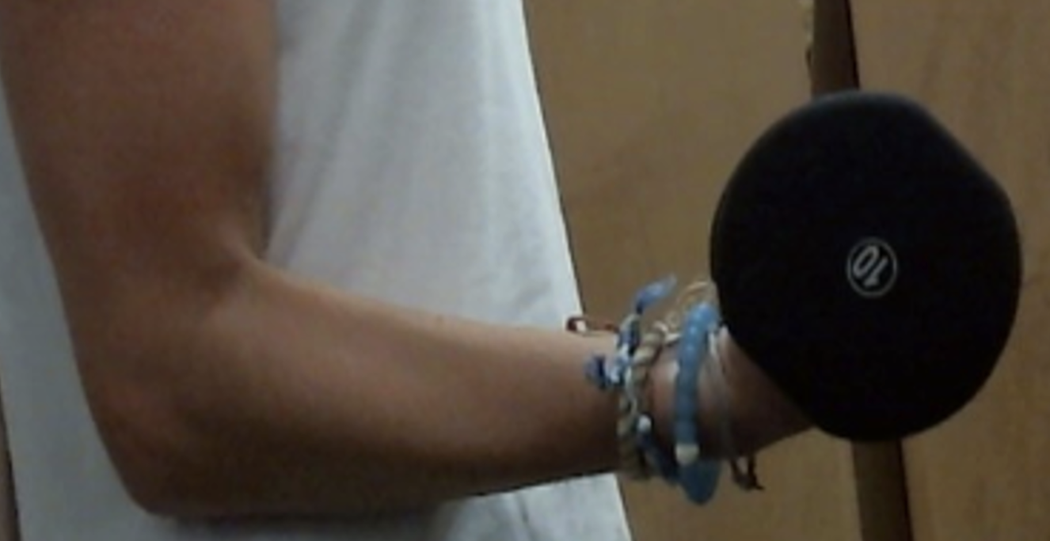
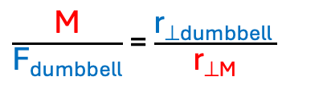
Biceps curl
She is hold her arm still, so forces and torques on the forearm/hand must balance
Limb system: forearm/hand
Joint: elbow
Torque Equilibrium condition
Στ = 0
Neglect the weight of the arm itself in this analysis
τ_{muscle =} τ_{dumbbell}
M r_{⊥M} = F_{dumbbell} r_{⊥dumbbell}
$\frac{\text{M}}{\text{F}\text{dumbbell}}$ = $\frac{\text{r}\text{⊥}\text{dumbbell} }{\text{r}\text{⊥}\text{M}}$
Force Equilibrium condition
ΣF = 0

Slide 2
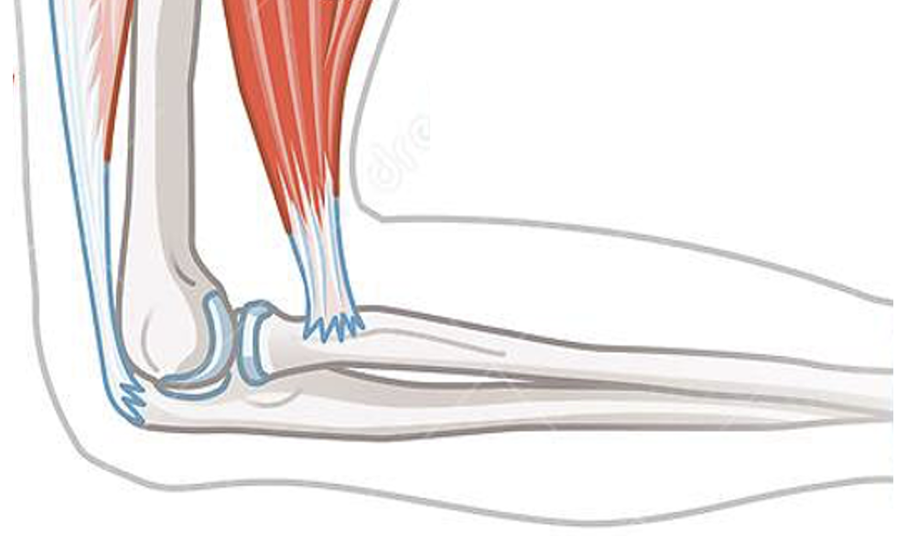
Limb system: forearm/hand
Joint: elbow
Drag or draw to visualize dumbbell force, F_{dumbbell} , its lever arm, r⊥, and its torque direction.
Drag to show elbow axis
4pts.
F_{dumbell}
r⊥
flexion
extension

Slide 3
Which muscle provides the counter-torque?
Drag or draw to show muscle force, its torque rotation direction, and lever arm, r⟂
Biceps
Triceps
M_{biceps}
M_{triceps}
r⊥
4pts.
3pts.
flexion
extension

Slide 4
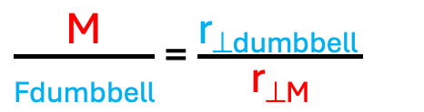
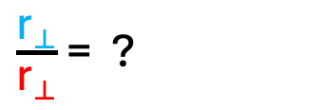
Limb system: forearm/hand
Joint: elbow
Drag to show elbow axis
r⊥
Drag to show lever arm distances
r⊥
Drag to show where forces applied
F_{dumbbell}
M
relative lengths of lever arms
$\frac{\text{r}\text{⟂}}{\text{r}\text{⟂}}$ = ?
How much larger is the muscle force compared to the dumbbell force Look at the ratio
$\frac{\text{M}}{\text{Fdumbbell}}$ = $\frac{\text{r}\text{⊥}\text{dumbbell} }{\text{r}\text{⊥}\text{M}}$
= ?
Resize force vectors to show relative values
Approximate the muscle force, if dumbbell is 10bs.
M = ? lbs.

Slide 5
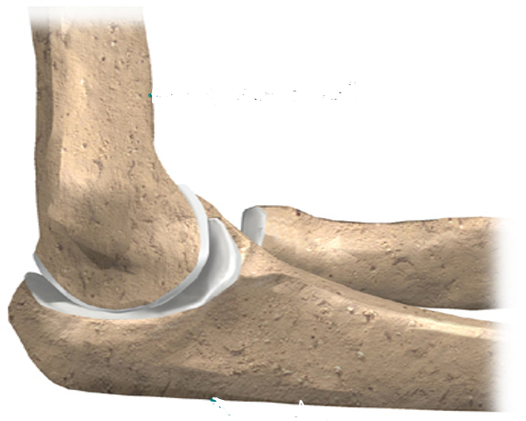
Joint force is the force of the two bones against each other at the joint
Forearm bone (ulna) on upper arm bone (humerus)
J_{elbow}
Upper arm bone (humerus) on forearm bone (ulna)

Slide 6
In this next section, assume all forces are vertical – for simplicity

Slide 7
Limb system: lower arm/hand
Joint: elbow
Drag or draw M and F_{dumbell} vectors showing relative size.
Drag or draw the elbow joint force needed to balance out the other forces (arm not moving)
M
F_{dumbell}
J_{elbow}
Force Equilibrium condition
ΣF = 0
(forces up forces down, if arm not moving)
Find the elbow joint force
Algebra: choose signs
∓ M ∓ F_{dumbbell} ∓ J_{elbow} = 0
J_{elbow} = ∓M ∓ F_{dumbbell}
Calculation
J_{elbow} = ? lbs.

Slide 8
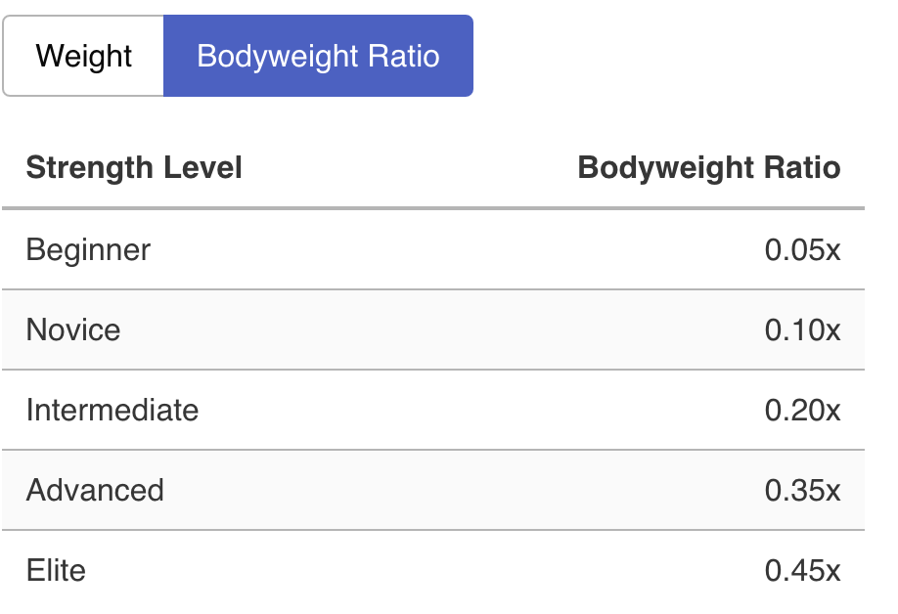
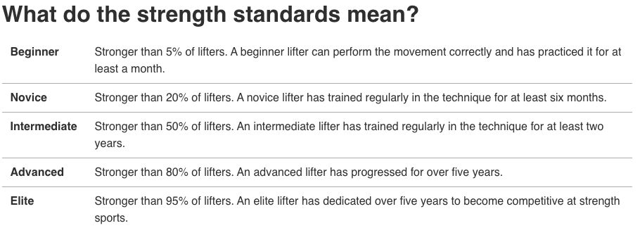


https://strengthlevel.com/strength-standards/dumbbell-curl/lb
Female Dumbbell Curl Standards
If she lifted at the Elite level
$\text{F}\text{dumbbel}$_{l} = 0.45w_{body}
What would her (biceps or triceps) muscle force be, in terms of body weight?
Indicate which muscle
M = ? w_{body}
Hint: Use the same arm lever arm ratio as before. That ratio wouldn’t change
$\frac{\text{M}}{\text{F}\text{dumbbell}}$ = $\frac{\text{r}\text{⊥}\text{n} }{\text{r}\text{⊥}\text{M}}$
What would her elbow joint force be, in terms of body weight?
J_{elbow} = ? w_{body}

